Slide 1

The harmonized approach to
Health facility assessments (HFA)
Amani SIYAM (PhD, MSc, CStat)
HMM/IER /GPM team
https://www.dropbox.com/sh/3uxvtl7tao78ina/AADHu-eVPELlshim8k0PBlCAa?dl=0
Strengthening HIS & CRVS
Kathryn O’Neill
Information, Evidence and Research, WHO

Slide 2
A Health Data Collaborative (HDC) shared vision
Brought about by the HDC "Health Facility Survey" working group of technical experts from partners, countries, academia, civil society as a deliverable of the HDC operational work-plan 2016-2017
Recognized many challenges to facility assessments:
  Uncoordinated with parallel reporting systems
  Critical data gaps remain (e.g. hospital reporting of deaths and cause of death; private sector is missed,…etc)
Two main objectives in sight:
  Review and harmonize facility survey modules, including standard indicators and measurement methods, instruments and analyses;
  Catalyze a joint/aligned support for ONE country system of facility surveys, based on a modular approach

Slide 3
A Health Data Collaborative (HDC) shared vision
Aligning investment and support to countries
TB
cMYP (immunization)
GLOBAL STRATEGY
HIV/AIDS
National Health Sector Strategic Plan
NCDs
MALARIA
OTHER HEALTH PROGR.
National overarching development plan
Common investment framework for M&E
FOUNDATIONS
GLOBAL FUND
BILATERAL/
MULTILATERAL
FUNDING
DOMESTIC
FUNDING
GAVI
GFF
Coordinated technical support and implementation
https://www.healthdatacollaborative.org/fileadmin/uploads/hdc/Documents/Country_documents/KHSSP_Statistical__Report_2016.pdf

Slide 4
Placing the HFA in the Country Planning and Review Process
Year 0
Year 1
Year 2
Year 3
Year 4
Year 5
Annual operational plans
Health sector performance analysis
Annual
reviews
Annual
reviews
Midterm
reviews
Annual
reviews
Final
reviews
Annual health sector progress and performance analysis
Routine reports
& admin data
Finance
HRH
Infrastructure
HMIS
Finance
HRH
Infrastructure
HMIS
Finance
HRH
Infrastructure
HMIS
Finance
HRH
Infrastructure
HMIS
Finance
HRH
Infrastructure
HMIS
DQR
DQR
DQR
DQR
DQR
Data verification
Data verification
Data verification
Data verification
Data verification
Health Facility assessments
Availability & Readiness
Availability & Readiness
Availability & Readiness
Availability & Readiness
Availability & Readiness
Quality of care
Management and Finance
Quality of care
Management and Finance
Quality of care
Household
Surveys
Household Survey
Household
Survey
Household
Survey
Vital event monitoring
CRVS SRS
CRVS SRS
CRVS SRS
CRVS SRS
CRVS SRS

Slide 5
A recap of previous discussions
Strengthening quality health services using facility information
WHO establishes standards in consultation with national/international expertise……
…then support governments to adopt standards, with country specific adaptations that do not undermine the original standards (i.e., sub-optimal standards should not be acceptable for a country just because the standard cannot be achieved at this time →country specific benchmarks along a continuum aiming to achieve the standard can be helpful)
WHO encourages country to implement systems for facility specific monitoring for adherence to standards
Facility and higher-level management:
HFA → periodic external validation of country findings on adherence to standards
- Countries get aggregate information on service status in view of standards—less needed if there is well-functioning national accreditation system
- Important for donors to ensure that national data reflects the actual situation
- An introspective review of results within a country and between countries over time – rather than just finding results acceptable
Supervision systems (possibly using checklists/record reviews/internal case reviews)
Monitoring systems (e.g., collection and use of data)
Systems for reviewing results and using these to improve services
Ideally countries will implement facility-specific accreditation/certification systems

Slide 6
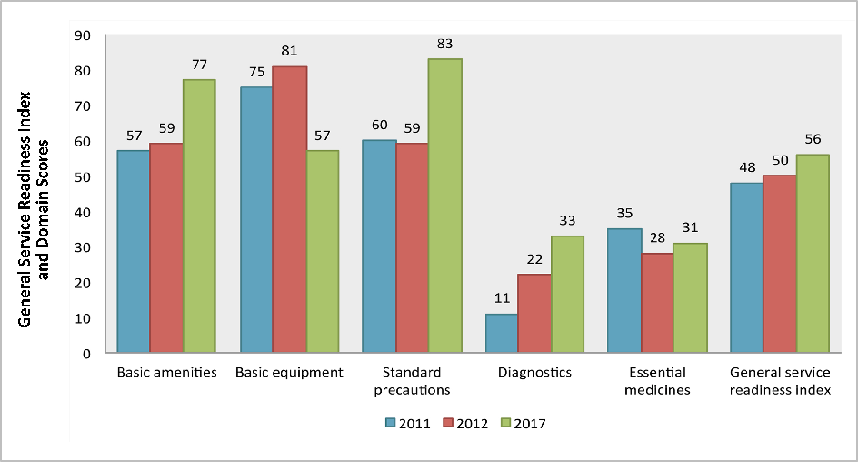
An introspective review of results within a country……..
Sierra Leone (2011-2017)

Slide 7
A recap of previous discussion
A harmonized modular approach to HFA
(building on existing facility surveys)
availability
readiness
Quality & safety
Management & Finance
DATA VERIFICATION
Infrastructure & amenities
General readiness
General and cross-cutting
Management practices
Cross-cutting
Staff and beds
Service-specific readiness
Patient care process
Finance
Programme specific
Diagnostics & treatments procedures
Utilisation & efficiency
Systems to support quality & safety & community linkages
Patient outcomes
Health worker absenteeism
Services offered
Patient perspective
Provider knowledge
Health Resources Availability Mapping System (HeRAMS)

Slide 8
A harmonized modular approach to HFA
MEASUREMENT METHODS
Facility audit
The data collector walks through the facility and collects information by interviewing the most knowledgeable person available on the day of the survey for the subject. Reported information on availability of equipment, commodities, documents, and systems are validated by observation of the items in the vicinity where they are needed to reasonably assume usage for the service in question
Provider interview
A provider is interviewed on their knowledge on clinical practices in specific service areas through a checklist or vignettes (can include one or more providers)
Record review
The data collector draws a sample from registers/records for eligible patients and then reviews registers and records for documentation of specific elements in the patient care process. If records are not maintained at the facility, the sample may be persons who received services the day of the survey whose patient card is reviewed on exit.
Client exit interview
The data collectors draws a sample from clients who received care in the facility on the day of the survey when they are leaving the facility. Items assessed may include client opinion, knowledge, or to review their health card. This may be service specific or general.
Observation of client-provider interaction
A checklist is used to record topics on which information is shared, examinations that are performed, and diagnoses and treatments for a sample of patients receiving services the day of the survey.

Slide 9
A harmonized modular approach to HFA
The language of Metrics and Measurement*
Data: information that is fed into indicators. This usually needs context and other data to compare with to give meaning.
Indicator: A measure, often formed with several components, that aims to describe, in a few numbers as much detail as possible about a system, to help understand, compare, predict, improve and innovate,
Metrics: Any set of data. An indicator is a particular sort of metric that identifies issues that may be worthy of further investigation, or calculating the status of services in context of indicators
Monitoring: The process of regular follow for specific indicators, with a view to action when a particular threshold is crossed.
Outcome: A measurable change in health status, sometimes attributable to a risk factor or an earlier intervention.
Balanced (set of indicators): A set of indicators which, taken together, reflect as much of a system as possible without duplication, overlap or gaps.
Benchmark: An externally-agreed comparator to compare performance between similar organizations or systems.
* The Good indicators Guide – Practical resource for those in the health system responsible for using indicators and to monitor and improve performance, systems or outcomes

Slide 10
A harmonized modular approach to HFA
SERVICE AVAILABILITY MODULE (…….showing a selection)
Facility infrastructure
  Facility density
  Outpatients routine services
  Building structural infrastructure
Staff and beds
  Number of inpatient beds by type (including emergency, intensive care, isolation)
  Health worker density and distribution
Diagnostics and treatment procedures
  Medical devices/ essential technologies
  Basic laboratory diagnostics
Patient services offered
  RMNCAH / Immunization / NTDs / NCDs
  HIV
    Any paediatric HIV services
    PMTCT (see RMNCAH/ ANC)
    HIV testing service (HTS)
    HIV care and support service (CSS)
    ART for life-long treatment
    VMCC services
    Occupational health services for HIV
  Malaria
    Malaria diagnosis and/or treatment
    IPTp during pregnancy
  TB
    TB diagnostic and treatment prescription service
    TB case detection and follow-up service

Slide 11
A harmonized modular approach to HFA
  SERVICE READINESS MODULE (…….showing a selection)
General readiness
  General service readiness
  Availability of essential medicines
  Safe blood transfusion conditions / Oxygen services / Laboratory safety
Service-specific readiness
  HIV
    Specific paediatric HIV services offered
    Service locations for paediatric HIV testing
    ART service readiness for paediatric patients
    HIV testing service (HTS) offered and readiness
    PMTCT
    HIV care and support services (CSS) offered and readiness
    HIV patients are tested for TB
    Cotrimoxazole prophylaxis among HIV-positives who are eligible
    Specific ART services for life-long treatment offered and readiness
    Specific VMMC services offered and readiness
    Specific occupational health services for HIV offered and readiness
    Malaria
    Specific malaria services offered and readiness
    IPTp service readiness (see RMNCAH/ ANC)
  TB
    Specific TB services offered
    TB diagnostic and treatment prescription service readiness
    TB case detection and follow up service readiness
    TB diagnostic lab conditions
    TB respiratory infection control readiness

Slide 12
A harmonized modular approach to HFA
  SERVICE READINESS MODULE (…….continued)
Systems to support quality and safety and community linkages (….showing a selection)
  General (Cross-cutting)
    Use of individual patient charts
    Laboratory management systems
    Provider level external supervision
    Patient referral systems for higher levels of care
  HIV
    System for linking paediatric HIV patients for future services
    Systems to support diagnosis of HIV/TB co-infection
    System to promote enrolment of HIV positive patients in care and support services
    System for quality assurance for HIV test
    Patient follow up systems for ART
    HIV testing service (HTS)
    VMCC system for patient follow-up
  Malaria
    Malaria diagnosis and/or treatment
    IPTp during pregnancy
  TB
    System for case detection
    System for patient follow up for TB treatment
    System for patient follow-up for TB drug resistant diagnosis and treatment
    First line TB drug stocking timeliness
Provider knowledge and competency (….showing a selection)
  Provider knowledge of standards for ART
  Provider knowledge on standards of IPTp
  Provider competency in diagnosing and treating malaria with anaemia
  Provider knowledge on standards for providing HTS for PMTCT
  Provider competency in diagnosing and treating TB in adults and children

Slide 13
A harmonized modular approach to HFA
Sierra Leone 2017 (SARA Plus)
Percentage of health facilities with tracer items for offering ARV services (N=514)
The mean availability of tracer items for the provision of ARV services is 31%. Readiness was largely reduced by the inadequacy of supportive laboratory services.
CD4 count, viral load test, and liver and renal function tests were available in only 2% to 4% of the 514 facilities providing ARV services.

Slide 14
A harmonized modular approach to HFA
QUALITY AND SAFETY OF CARE MODULE
Facility adherence to standards (….showing a selection)
  External facility review accreditation/certification status
  Pharmaceutical storage conditions to protect quality of drugs
  Standard precaution for infection prevention in all service units
  TB drug storage practices
Service specific QoC (….showing a selection)
  HIV
    Patient care process
      Adherence to standards of care for paediatric/adult ART services
      Adherence to standards of care for HTS services
      HIV care coverage
      ART coverage
      HIV patients receiving TB prophylaxis
      Adherence to standards of care for VMCC
    Patient outcomes
      HIV viral load suppression

Slide 15
A harmonized modular approach to HFA
  QUALITY AND SAFETY OF CARE MODULE (…….continued)
Service specific QoC
  Malaria
    Patient care process
      Confirmed malaria cases
      Malaria diagnostic test rate
      Confirmed malaria cases receiving treatment
      Malaria cases (suspected and confirmed) receiving treatment
    Patient outcomes
      Correct assessment and treatment for suspect malaria cases (adult and child)
      Malaria test positivity rate
  TB
    Patient care process
      Adherence to standards of care for initiating TB treatment
      Adherence to standards for drug-susceptible TB treatment
      Drug susceptibility testing coverage for TB patients
      HIV test results for TB patients
      TB patients with HIV positive test results
      HIV patients receiving TB prophylaxis
      Adherence to standards for HIV/TB coinfection in ART patients
      HIV-positive new and relapse TB patients on ART during TB treatment
    Patient outcomes
      MDR-TB/RR-TB treatment coverage
      Coverage of HIV positive patients for latent TB infection (LTBI)
      Coverage of household contact children <5 for latent TB infections
Patient perspective (…….showing a selection)
  Patient satisfaction

Slide 16
A harmonized modular approach to HFA
(Example of HIV QoC, Sierra Leone SARA Plus Report 2017)

Slide 17
A harmonized modular approach to HFA
MANAGEMENT AND FINANCE MODULE
Management Practices (….showing a selection)
  Management systems to support facility functionality, efficiency, and accountability
  Facility-level external supervision for management
  Drug management systems
  Systems for maintenance and repair
  Facility use of information for management
Finance (….showing a selection)
  Knowledge of costs and budget accountability
  Accountability for user fees
  Financial accountability
  Median consumer price ratio of selected medicines
Utilization and efficiency (….showing a selection)
  Health care provider case load (inpatient / outpatient)
  Staffing complement
  Waiting time to elective surgery
  Health worker in facility by cadre
Health worker absenteeism

Slide 18
A harmonized modular approach to HFA
  DATA VERIFICATION MODULE (…….showing a selection)
Cross-cutting
  Verification of reported OPD visits
Service specific (….showing a selection)
  Verification of reported IPTp3
  Verification of PMTCT ART Coverage
  Verification of reported people currently on ART
  Verification of reported ART retention
  Verification of HIV test results for registered new and relapse TB patients
  Verification of reported suspected malaria cases tested
  Verification of reported patients receiving HIV care
  Verification of TB treatment success
  Verification of TB notification rate
  Verification of TB treatment success
  Verification of MDR-TB treatment success

Slide 19
A harmonized modular approach to HFA
  REFLECTIONS ON MEASUREMENT METHODS
The readiness is useful to capture gaps when items are not available and the service is not provided. Often though it is not a lack of commodities that influences the service, but rather what the provider chooses to practice.
Record reviews are the primary way to monitor the quality individual patient care across a disease. Observation is best for assessing the total physical and assessment process regardless of illness.
The provider competency and knowledge: For example for PMTCT, do provide good information particularly for helping to explain why some services are not consistently provided.
The key weaknesses seems to be process and providers who are not aware of parts of the care process (e.g. follow-up test for HIV negative). These can be addressed through education, but even more effectively—job aids and supervision that reinforces that a practice should be implemented.

Slide 20
A harmonized modular approach to HFA
(Using either a census or a sample of representative facilities)
Allows profiling of facilities so a picture of service availability, readiness, quality and management can be presented and monitored for change
A Precursor to an accreditation process—set standards against which facilities are to be measured and classified
  Benchmark levels at which facilities/geographic management units can be classified for quality
  Standards apply to individual facilities, but for sample surveys results can be presented as the percentage of facilities within a district/region that have achieved Level 1, Level 2, etc.

Slide 21
A harmonized modular approach to HFA
(Using either a census or a sample of representative facilities)
An illustrative example of general facility classification
Level 1 : Facility has adequate infrastructure - routine availability of electricity, water, sanitation for patients and staff, waste disposal, external communication, etc. for all major service sites (TBD)
Level 2: Level 1 plus basic patient examination equipment and infection control items available in outpatient service area, basic laboratory tests available, % (TBD) of WHO essential medicines available
Level 3: Level 2 plus service package and additional key items for the services in the package
Level 4: Level 3 plus management practices to support quality services (TBD)
  Certify facilities every x years as meeting standards for Level X

Slide 22
A harmonized modular approach to HFA
(Using either a census or a sample of representative facilities)
An illustrative example of service specific classification for delivery services
Level 1 : Facility has adequate infrastructure and IPC in delivery service area,
        provides BEmONC signal functions, has items for BEmONC signal functions, has basic supplies and equipment for normal vaginal delivery
Level 2: Level 1 plus provides defined set of interventions for complicated deliveries, basic supplies and equipment for interventions for complicated deliveries
Level 3: Level 2 plus EmONC services with supplies and equipment for EmONC services
Level 4: Level 3 plus management practices to support quality services (TBD)
Level 5: Level 4 plus individual patient records pass quality of care record reviews
  Certify facility every x years as meeting standards for Level X

Slide 23
Regular system of monitoring service availability, quality and effectiveness (through health facility assessments)
Availability
(Core, extended)
Facility infrastructure
Readiness
(Core, extended)
General readiness
Quality of care and Safety
Facility adherence to standards and 16 cross-cutting QoC indicators
Staff and beds
Patient services offered
Diagnostics and treatment procedures
Systems to support quality and safety and community linkages
Provider knowledge and competency
Patient outcomes
Service specific
Patient outcomes
Patient perspective
General
Patient care process
Patient care process
Immunization
Malaria / HIV / TB
NTD
NCD (CVD, CRD, Diabetes, Cancer, Surgery, Emergency care)
RMNCAH
Medical devices/essential technologies
IPTp
neonatal asphyxia
HTS for PMTCT
Hypertension in pregnancy
Service specific readiness
Treating malaria with anaemia
Standards for ART
Treating TB in adults and children
Diagnosing and treating hypertension, CRD, diabetes
Respectful maternity care
Patient satisfaction
Patient experiences with ambulatory care
Blood transfusion
Oxygen administration
Basic laboratory diagnostics

Slide 24
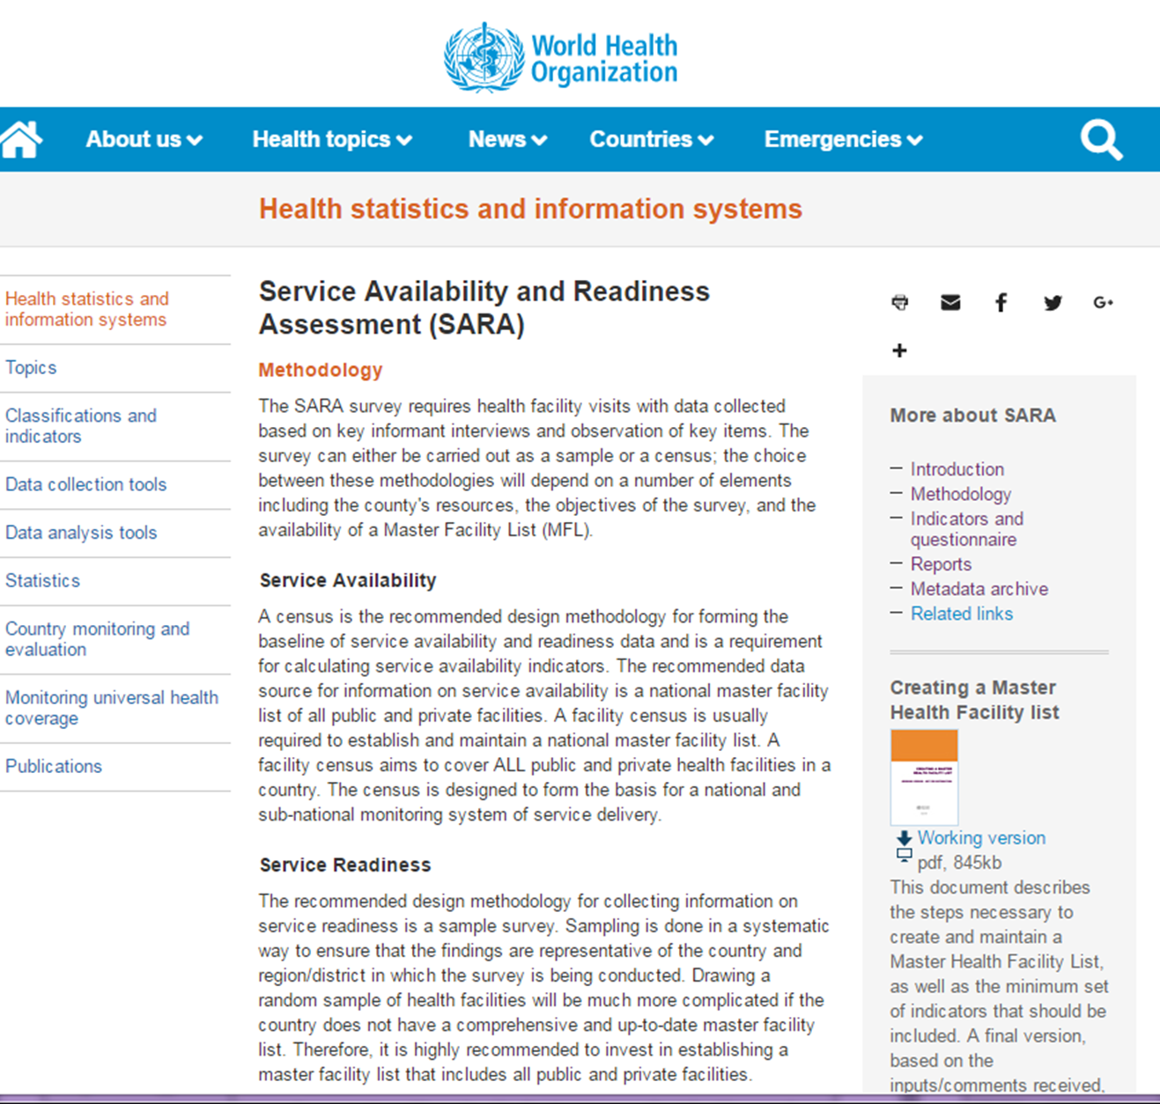
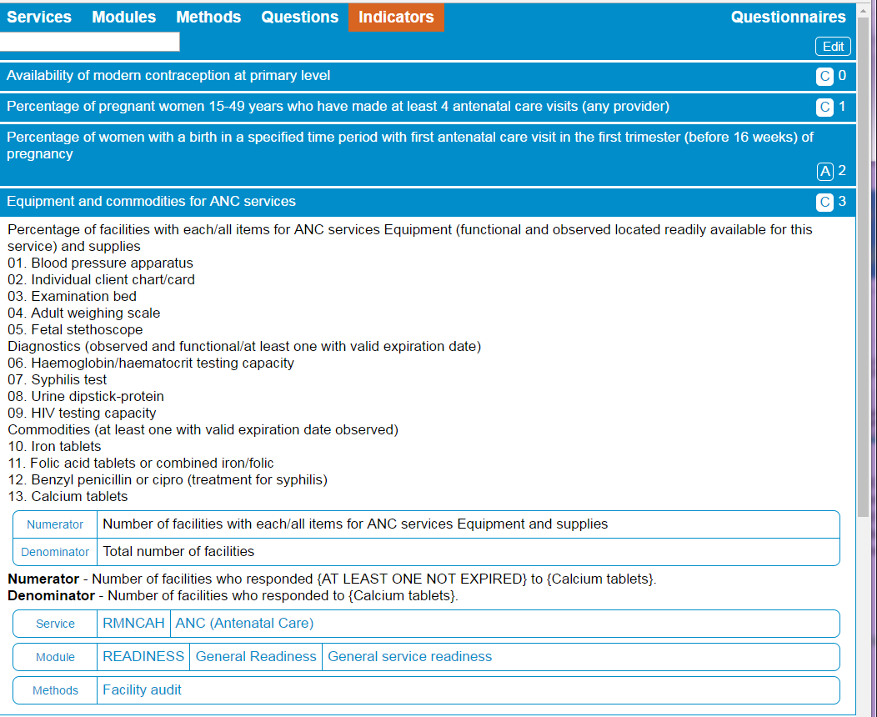
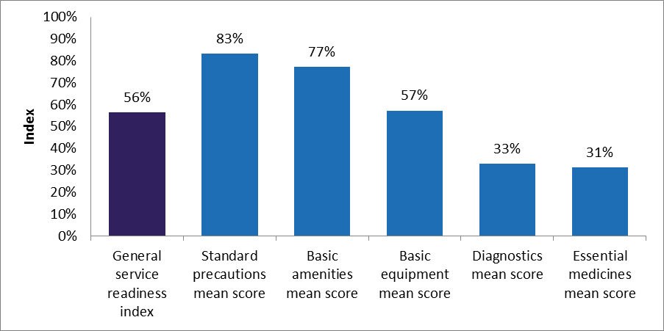
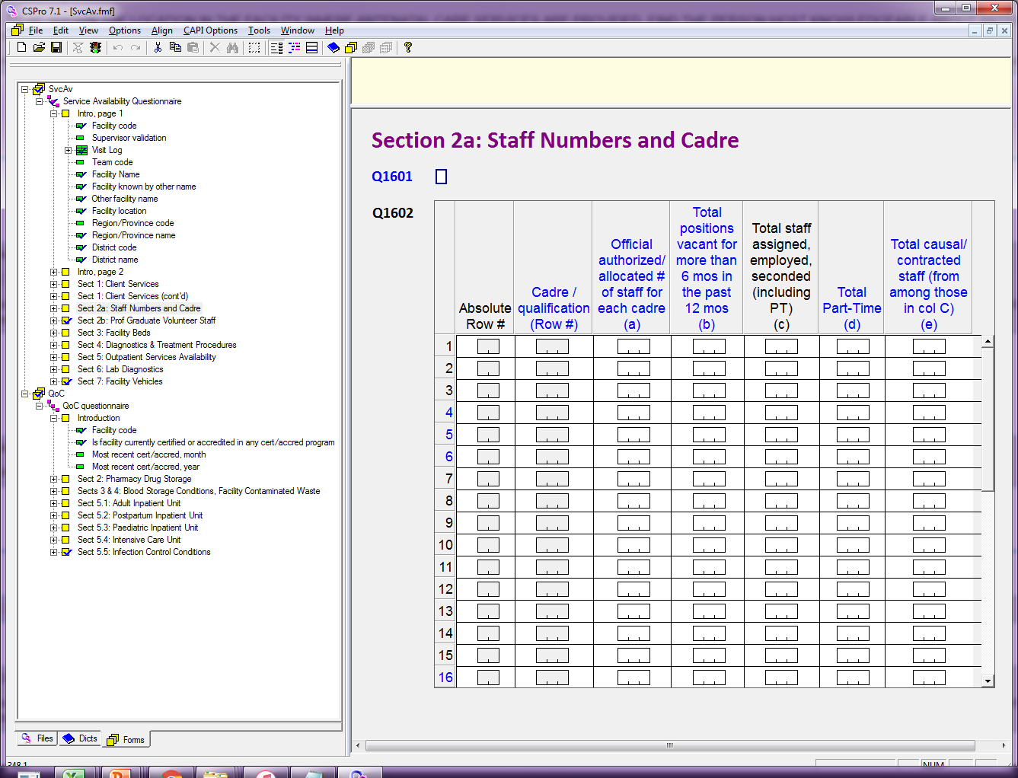
Regular system of monitoring service availability, quality and effectiveness
(through health facility assessments)
Key milestones and developments
Launch platform
Tools, guidance, analytics compiler
Data repository
Generate spotlight analytics and visualizations
Pilot-testing 2-3 countries
Data entry tools and TR material
CSPro
LimeSurvey
Questions Bank
Finalizing modules
Jan – May 2018
June - July 2018
September 2018
October – Dec 2018
TBC xx 2019

Slide 25
HFA 2018 edition
WHO Programme updates

Slide 26
HFA 2018 edition
Data entry utility (…underdevelopment)

Slide 27
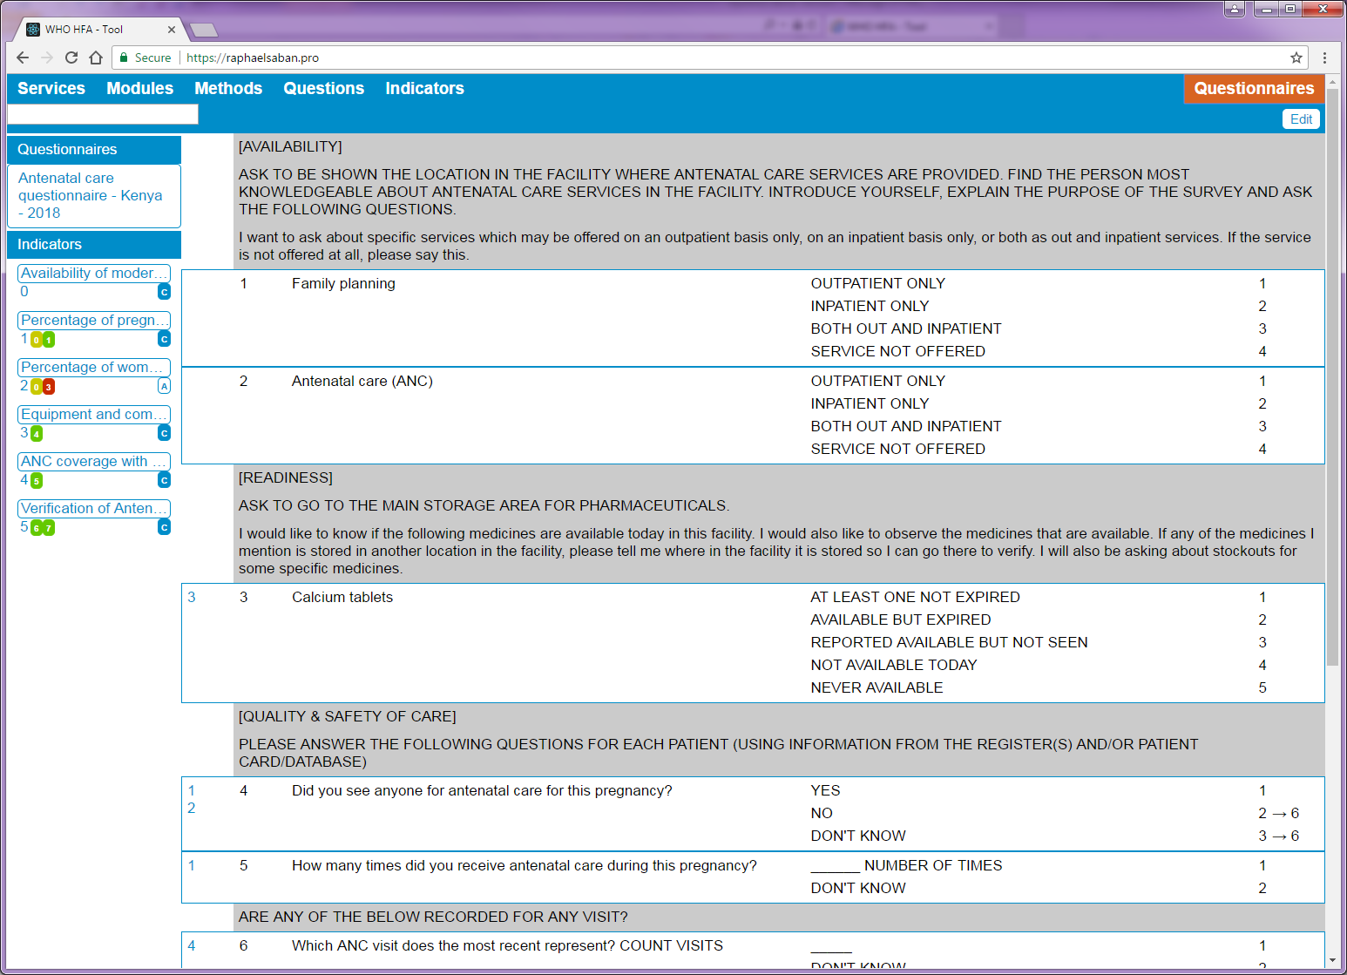
HFA 2018 edition
Question bank (demo)

Slide 28
HFA 2018 edition
References (showing a section)

Slide 29
HFA 2018 edition
Country pilot-testing
(showing an example of current activities…..)

Slide 30
A harmonized modular approach to HFA
The summary
IT IS NOT MEANT TO:
Provide the same information collected by supervisors and internal monitoring systems—these may look at all items required for meeting standards
Replace routine supervision and monitoring—using the HFA to collect information that should be part of routine M &E can weaken the incentive to establish effective systems —”we don’t need to monitor this….periodically donors will come in and assess this for us” .
Provide new information to managers—except where this is being used to show need for improved internal systems—they should know strengths and weaknesses in their systems/services/quality from supervisors and reports.
Its purpose is to :
Provide external validation of findings by country/facility systems
Provide comparable data across geography and time because there is a massive need and responsibility to ensure similar methods, definitions in collecting information—measuring every indicator

