Slide 1
Digital Health Resources for COVID-19
July 13, 2021

Slide 2
Agenda
Inventories of existing country digital systems and mapping to COVID-19 use cases by country
Map and Match (USAID and Digital Square)
UNICEF Mapping Tool
New guidance and tools, and how to use them to inform country support
Digital Square and Map and Match Resources
Digital Pandemic Preparedness Assessment Tool
COVID-19 Digital Health Center of Excellence (DICE) Overview:
What it is and how it can be used to support country digital health systems strengthening in the context of COVID-19
Discussion

Slide 3
Agenda
Inventories of existing country digital systems and mapping to COVID-19 use cases by country
Map and Match (USAID and Digital Square) - Presented by Vrunda Rathod, Digital Square, vrathod@path.org and Merrick Schaefer, USAID mschaefer@usaid.gov
UNICEF Mapping Tool - presented by Vrunda Rathod
New guidance and tools, and how to use them to inform country support
Digital Square and Map and Match Resources
Digital Pandemic Preparedness Assessment Tool
COVID-19 Digital Health Center of Excellence (DICE) Overview:
What it is and how it can be used to support country digital health systems strengthening in the context of COVID-19
Discussion

Slide 4
Digital Tool Mapping for COVID-19

Slide 5
Why Map & Match?
Key Lesson from Ebola:
Adapting existing digital tools rather than deploying new ones helped:
Speed of deployment
Save money
Reduce duplicative investments
Lead to sustainable tools
Increase government leadership
Enable exchange of data
Notes:
Keep short -- and just mention.
Off- ramp: report
Please share link in chat:
https://www.usaid.gov/sites/default/files/documents/15396/FightingEbolaWithInformation.pdf

Slide 6
Map & Match Goals
Map existing digital health tools deployed at scale in country.
Identify digital health tools already deployed for COVID-19 response and vaccine distribution
Identify digital health tools that can be adapted for COVID-19 response and vaccine distribution
Notes:
Quick slide
Goal for Map and Match is to map the tools that already exist in county and can be adapted and scaled quickly.

Slide 7
Map & Match Overview
Phase 1:
Initial Mapping
135 countries
Rapid assessment through a desk based literature review
High-level gap analysis between deployment/adaptations across countries
Phase 2:
Expanded Mapping and Country Profiles
22 countries
Expand research to include global and country surveys
Interviews with open-source software developers to understand adaptations
Interviews with Ministry of Health officials to understand Ministry priorities

Slide 8
Investor and Partner Coordination
Coordination and alignment has been a key tenant throughout the Map and Match project.
Notes:
During the Map and Match project, our team worked closely with other organizations to coordinate our efforts. We aligned both USAID and GIZ use cases. We worked with partners to develop our survey tool, help us understand how to define our use cases, and understand scale.

Slide 9
Structuring information: use cases
A ‘use case’ refers to a specific type of information collected, stored, tracked, analyzed, or visualized as it relates to the functional response to an epidemiological event, specifically COVID-19. One digital health tool can be deployed for multiple ‘use cases’.
Case management
Contact tracing
Data science assets
Event-based surveillance
Health facility & provider administration
Infection prevention control
Laboratory systems
Learning & training
One Health
Points of entry
Risk communication & community engagement
Routine surveillance
Supply chain
Vaccine planning, monitoring and delivery*
* Added for COVAX

Slide 10
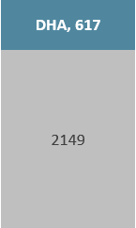
Phase I Findings
Phase I: July 20 – October 2020
749
2,910
78%
Documents, websites, reports, and landscapes submitted and reviewed.
# digital tool deployments identified
% of digital deployments NOT identified in the Digital Health Atlas
Notes:
Vrunda/ Amanda start: The Digital Health Atlas is the largest repository of digital health tools globally. 78% of the tools we found were not in the Digital Health Atlas.

Slide 11
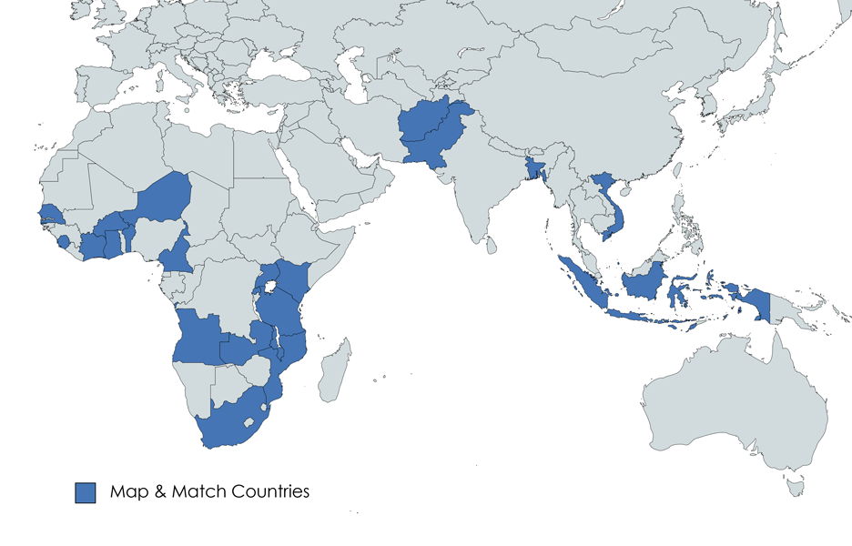
Map & Match Phase 2
The 22 countries with briefs already developed or forthcoming include:
Afghanistan, Angola, Bangladesh, Benin, Burkina Faso, Cameroon, Côte d’Ivoire, Ghana, Indonesia, Kenya, Malawi, Mozambique, Niger, Pakistan, Rwanda, Senegal, Sierra Leone, South Africa, Tanzania, Uganda, Vietnam, and Zambia.

Slide 12
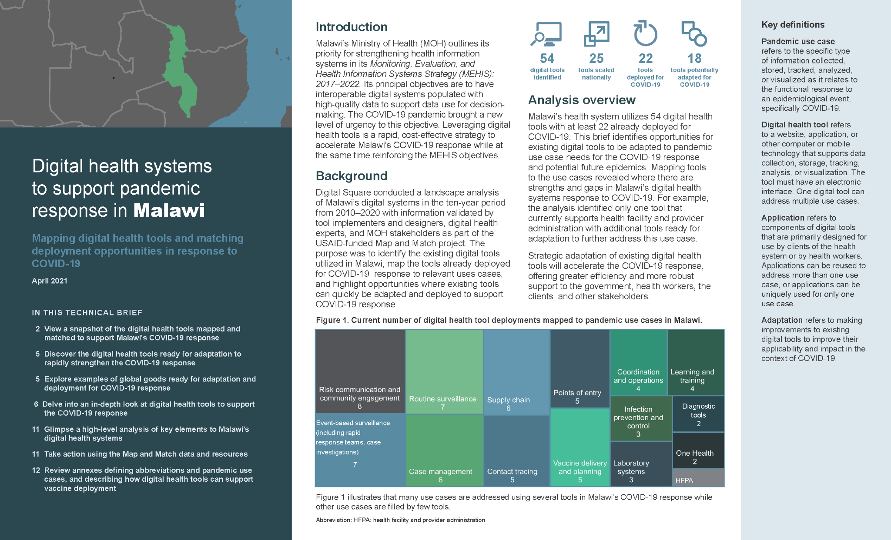
Country Briefs
Map & Match created easy to read analysis for each of the 22 countries in Phase 2.
There is a lot of variability in the information found through our assessment. Some countries have tools for all use cases, many of which are already being adapted and used to support COVID response. Many still rely on paper-based tools and have limited use and scale of digital technologies.
Notes:
Through this project, Digital Square developed a highly visual brief for each country, identifying which tools are currently in use in the country, which tools have already been used in the country’s COVID-19 response, and where there are opportunities for quick adaptation of existing tools across COVID-19 response use cases. Digital Square prioritized dissemination of the country briefs and supplemental resources with national governments, investors, and other stakeholders.
How to use country briefs:
Identify what information exists about current tools used in countries and how those tools are currently being used in the pandemic response.
Identify opportunities to adapt and scale current tools for expanded use cases.
Identify gaps - i.e. where some countries may not be using any tools for things like laboratory information systems for the pandemic.
Use this information in conversations with Ministries of Health about where and how they want to use digital health technologies in the pandemic response.
For countries with limited digital tools already in use, recommend using the information to adapt and scale what tools they have AND looking at tools available that map to use case gaps.
For countries already using many tools, the information in the briefs offer opportunities to address any current gaps. It is also an opportunity to look at how tools are being used in the response and support the government to enable interoperability of tools as well as explore advanced analytics to inform decision making.

Slide 13
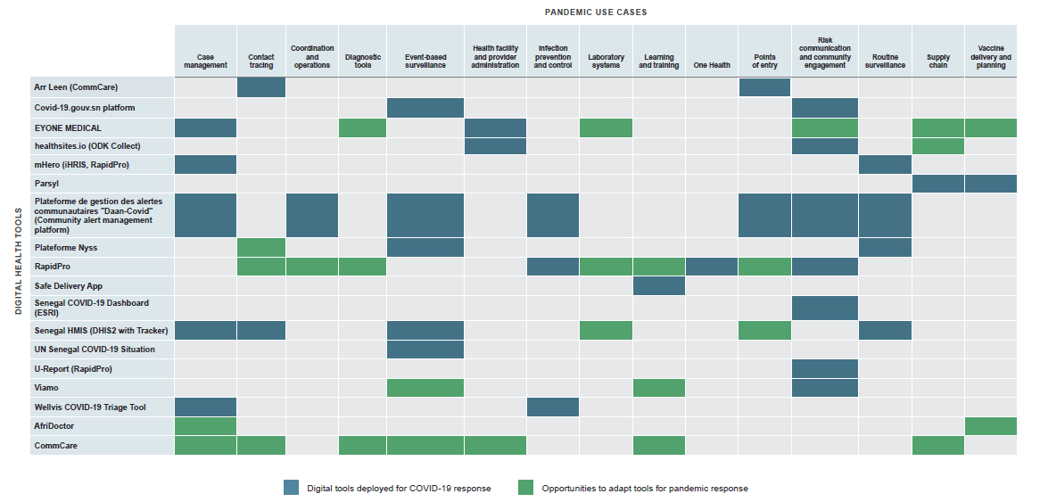
Country Briefs (III): A look at tools
The briefs provide an overall mapping of all the tools in country, highlighting both current COVID-19 use cases (blue) and possible adaptations (green). This allows for staff to quickly scan the existing tools and in country and see what use cases are there tools for and where the opportunities lie.

Slide 14
Country Briefs (IV): In-depth look at existing tools
In addition to summary information, the briefs provide descriptions of tools used in each country, highlighting both current COVID-19 use cases (blue) and possible adaptations (green). Where the information was available, the briefs display funders, implementers, and scale information. Licensing information is also included to enable implementers to consider the price of the software upfront.

Slide 15
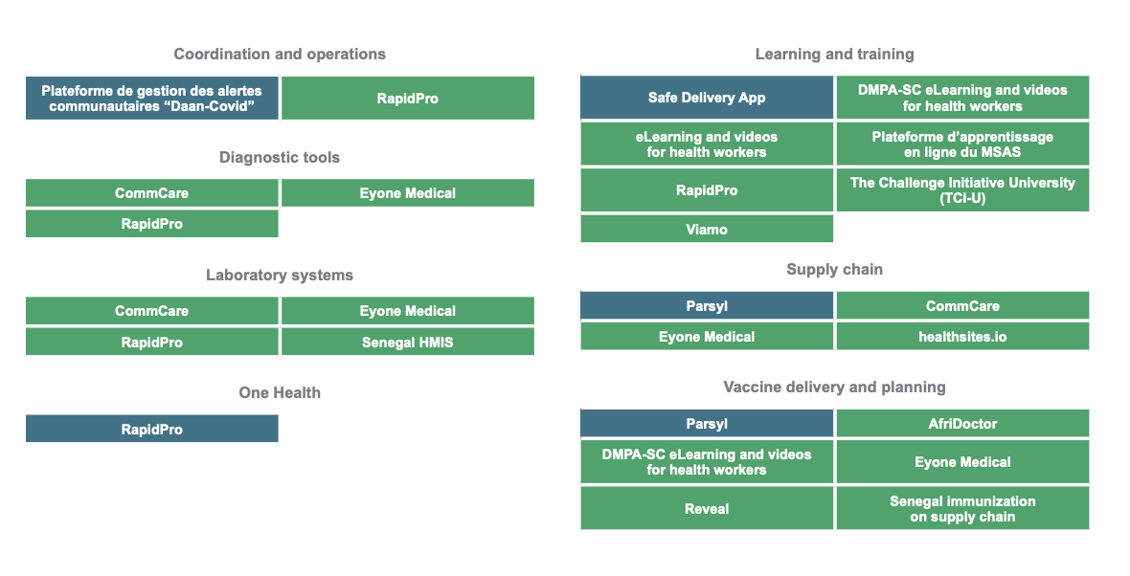
Country Briefs (V): Opportunities
Briefs also showcase digital health tools that can be adapted for other use cases.
For example, Commcare, a digital health tool deployed in malaria program in Senegal has been adapted for COVID-19 use cases in other countries. Commcare can be adapted in Senegal for Lab systems and supply chain.
Notes:
Through this project, Digital Square developed a highly visual brief for each country, identifying which tools are currently in use in the country, which tools have already been used in the country’s COVID-19 response, and where there are opportunities for quick adaptation of existing tools across COVID-19 response use cases. Digital Square prioritized dissemination of the country briefs and supplemental resources with national governments, investors, and other stakeholders.
How to use country briefs:
Identify what information exists about current tools used in countries and how those tools are currently being used in the pandemic response.
Identify opportunities to adapt and scale current tools for expanded use cases.
Identify gaps - i.e. where some countries may not be using any tools for things like laboratory information systems for the pandemic.
Use this information in conversations with Ministries of Health about where and how they want to use digital health technologies in the pandemic response.
For countries with limited digital tools already in use, recommend using the information to adapt and scale what tools they have AND looking at tools available that map to use case gaps.
For countries already using many tools, the information in the briefs offer opportunities to address any current gaps. It is also an opportunity to look at how tools are being used in the response and support the government to enable interoperability of tools as well as explore advanced analytics to inform decision making.

Slide 16
UNICEF Digital Systems Mapping
Increased access to actionable, data-driven insights and improved service delivery through the understanding of existing digital health ecosystem​
Categories around the priority problem areas and opportunities identified by the WHO-UNICEF COVAX Vaccine Delivery Innovation Team ​
Sources: ​
Country consultations​
USAID Map and Match​
Digital Health Atlas​
INVENT​
Gates Ventures & World Bank DH Landscaping​

Slide 17
Agenda
Inventories of existing country digital systems and mapping to COVID-19 use cases by country
Map and Match (USAID and Digital Square)
UNICEF Mapping Tool
New guidance and tools, and how to use them to inform country support
Digital Square and Map and Match Resources - Presented by Vrunda, Digital Square, abendor@path.org and Merrick Schaefer, USAID mschaefer@usaid.gov
Digital Pandemic Preparedness Assessment Tool - Presented by Tessa Lennemann, GIZ tessa.lennemann@giz.de
COVID-19 Digital Health Center of Excellence (DICE) Overview:
What it is and how it can be used to support country digital health systems strengthening in the context of COVID-19
Discussion

Slide 18
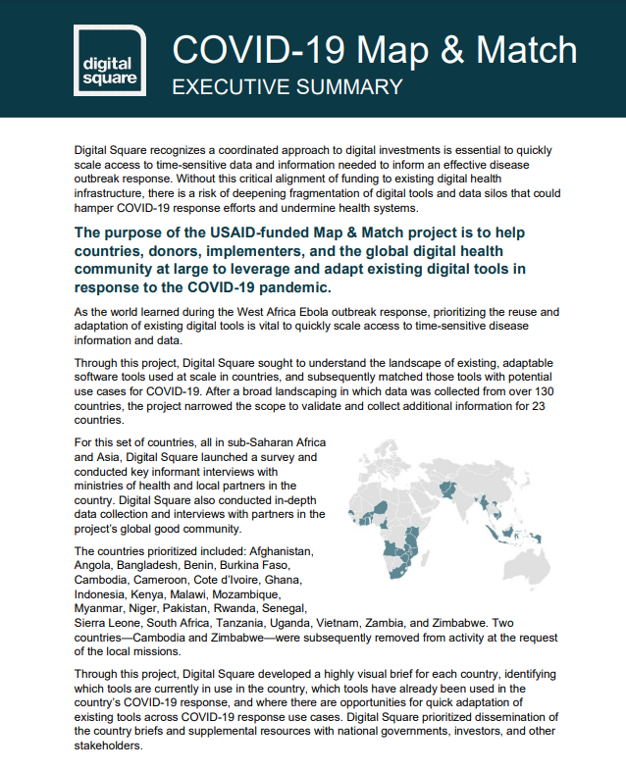
Additional Map & Match Outputs
Executive summary/overview of the project.
Annex information about digital tools which support vaccine deployment.
Map & Match survey tools (data model).
Final data set of Phase I and Phase II data
Global Goods COVID-19 adaptations
Digital Applications and Tools Across an Epidemiological Curve (DATEC)
Scale framework
Digital Square | connecting the world for better health
Notes:
Make a note re request to complete information about tools
https://digitalsquare.org/covid19-map-match

Slide 19
Additional resources available from Digital Square
Use the Global Goods Guidebook to learn more about the over 30 approved Digital Square global goods. The guidebook includes more information on the individual tool and specific information on use of the tool in the COVID-19 response.
Resources on the Digital Square wiki are regularly updated to feature global good adaptations. Information from JHU, UNICEF, and other partners is also maintained on the wiki to link the community to important initiatives in the ecosystem.
https://wiki.digitalsquare.io/index.php/COVID-19

Slide 20
DPPA - Discussing country software landscape in the context of pandemic use cases
Aim of Digital Pandemic Preparedness Assessment (DPPA):
Map out the existing software landscape against pandemic use cases
Gap analysis and mitigating actions
Discussion with national stakeholders to:
Built consensus on need
Develop priorities and rank actions
Identify “patrons” for different gaps
Identify funding opportunities
(Monitor progress?)

Slide 21
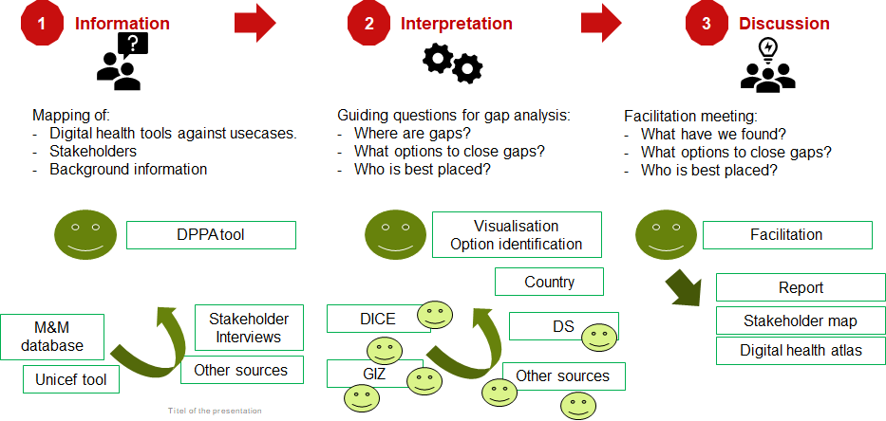
DPPA Process

Slide 22
How to use DPPA and other assessment tools
DPPA available on the digital square web page:
AN INTRODUCTION FOR STAKEHOLDERS (SLIDE DECK) This document provides background context, methodology, and other information about the development of the Digital Pandemic Preparedness Assessment Tool.
INSTRUCTIONS (SLIDE DECK) This document provides procedural guidance for DPPA implementation and interpretation. It follows the structure of the DPP Assessment Tool Excel File.
DPP ASSESSMENT TOOL TEMPLATE The DPP Assessment Tool Excel File provides a template for partner countries and other stakeholders.
DPP ASSESSMENT TOOL EXAMPLE This Excel File provides an example of a completed DPP assessment.
Contact for DPPA support: digital-health@giz.de OR tessa.lennemann@giz.de

Slide 23
Why should I use DPPA?
Structured and comprehensive assessment helps to:
Define Gaps and Priorities
Identifies opportunities to extend use of existing applications
Identifies duplications
Supports stakeholder harmonization
Allows to cost needs & apply for funding
Contributes to:
Development of a comprehensive digital health system
Makes countries comparable
Supports cross-country and international collaboration

Slide 24
COVID-19 digital health Centre of Excellence (DICE)
Karin Källander, Senior Health Advisor
Chief Digital Health & Information Systems Unit
UNICEF Programme Division
New York
kkallander@unicef.org

Slide 25
Digital solutions and innovations can support COVID-19 vaccine delivery
Challenge
LMIC health systems are under severe stress in their abilities to manage routine health services during the COVID-19 pandemic, while responding to the pandemic and rolling out COVID-19 vaccines
Opportunities
Sustainable and scalable deployment of carefully chosen digital health interventions can support health priorities in the context of the COVID-19 pandemic, as well as post-pandemic health systems strengthening needs.
Digital health investments can lead to more equitable coverage of quality health services, including vaccines, through increased use of data and evidence.

Slide 26
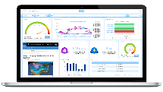
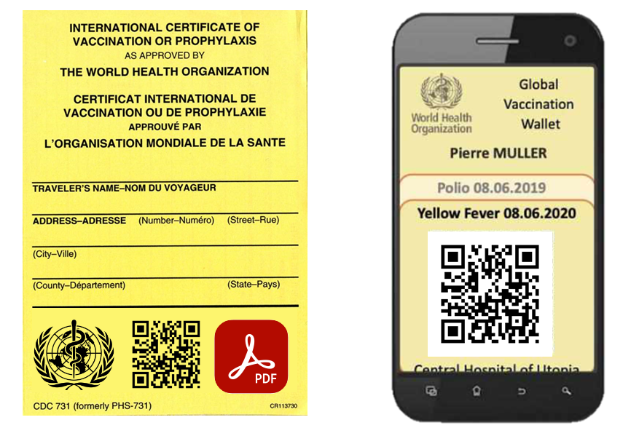
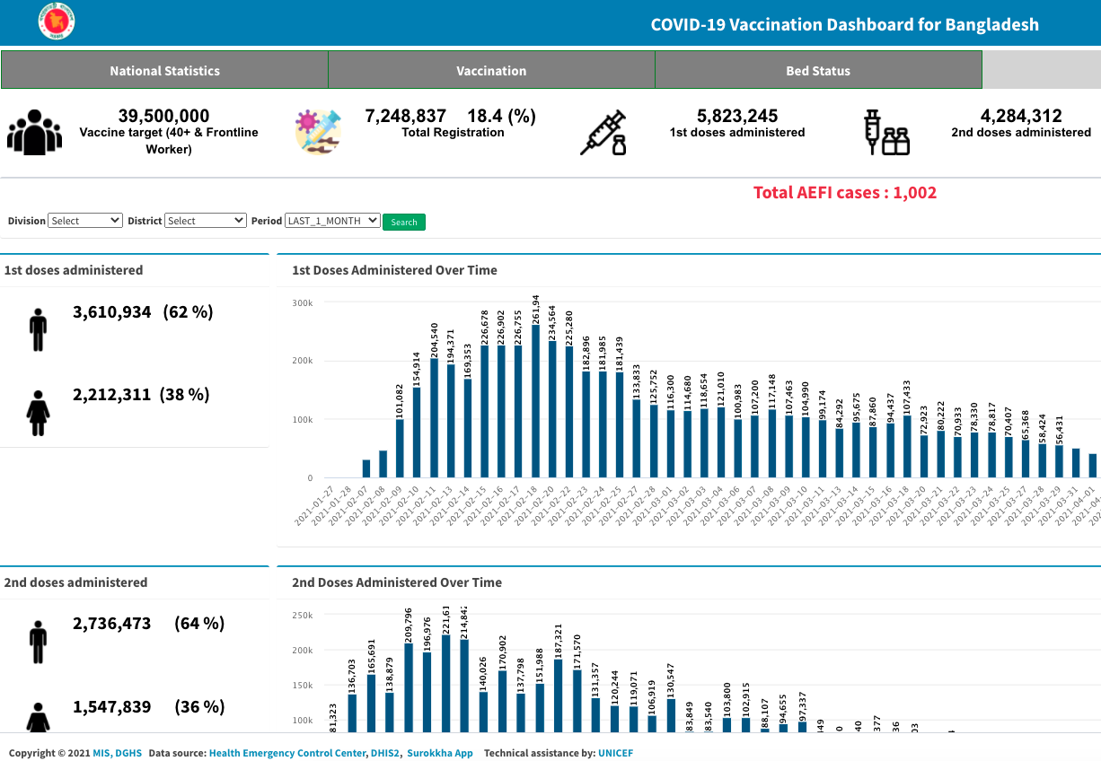
COVAX Innovation Working Group: Priority problem areas and solutions
HEALTH WORKER TRAINING
MICRO PLANNING
Health worker training
Micro planning
RTM CAMPAIGN MONITORING
Real time campaign monitoring
Counterfeit detection
COUNTERFEIT DETECTION
Safety monitoring
Vaccination status
Vaccination monitoring
SAFETY MONITORING
VACCINATION STATUS
VACCINATION MONITORING

Slide 27
What is the Digital Health COE (DICE)?
The DICE is a multi-agency consortium with a UNICEF-WHO co-hosted secretariat. UNICEF will run day-to-day activities and will manage funding for operations.
The DICE will provide coordinated, standardized support to Governments, initially responding to support requests for preparation and deployments of mature digital technologies to support health service delivery in the context of the COVID-19 pandemic
DICE will align with donor agencies and support Governments to identify and apply for funding for deployments using costed investment cases

Slide 28
Principles for Digital Health Support for COVID-19
UNICEF, WHO and partners are working with partners to support deployment of robust, mature and easily scalable digital solutions using globally endorsed principles:
Demand driven: Prioritizing country support that aligns with needs outlined in the National Deployment and Vaccination Plans (NDVPs)
Agile: Establishing contracting mechanisms with approved vendors and technical experts to allow for a rapid response to country COVAX priorities
Sustainable: Supporting Governments to use existing systems and resources to deploy cost-effective digital solutions with COVID-19 specific functionalities, which later can be expanded and integrated into the health management information system.
Secure: Safeguarding the global principles of digital development by only endorsing digital platforms that apply acceptable security standards for patient privacy and cyber security.
Capacity building: Providing guidance and technical assistance to Governments on digital health investments, including vendor selection, platform set-up, training and maintenance

Slide 29
COVID-19: What are the needs right now?
Diagnostics, treatments and vaccines are being rolled out now, yet many countries do not have the digital systems or solutions required to support microplanning, remote health worker training, surveillance, monitoring of service uptake, demand creation and programme monitoring.
Governments, donors and International Organisations at country level are reaching out with requests to urgently support, yet there is often not sufficient capacity at HQ or ROs to meet these needs.
With its current structures UNICEF, WHO and partners will not be able to deliver on its core commitments to the ACT-A and its COVAX facility:
Technical assistance to CO’s for digital solutions support may be of poor quality, and not meet national demand.
Digital investments may be poorly selected and coordinated, potentially leading to fragmented implementation of unsustainable solutions which further weaken already weak health systems.

Slide 30
Who supports DICE?
Private sector partners
Endorsing Organizations
Participating organisations – Funding DICE core functions
Endorsing organizations – Indirect DICE funding and direct country funding through various mechanisms; staff secondments
Private sector partners – Funding DICE core functions, funding for direct country support, in-kind support
Participating Organizations

Slide 31
What areas can DICE support?
Knowledge management
Deployment support
Country guidance
Coordinate between donors and development partners at Regional and Global level
Review Concept Note, TORs, Business Requirements and Proposals
Provide Guidance & support Implementation of assessment tools
Advise on existing Digital Global Goods, including existing evidence and plans to scale/institutionalize
Provide recommendations /support in contracting technical experts and partners
Support capacity building, training and knowledge exchange
Capacity building
Technical assistance
Partnership mobilization
Readiness assessment
Business analysis
Platform mapping

Slide 32
How will the DICE function?
Core team of experts, roster of consultants, and standby partners
Generation and use of strategic Long Term Agreement for Services (LTAs), Partnership agreements
Donor coordination and alignment of investments
Standardised TA to Government and UN Agencies on readiness assessments, business requirements, platform analysis, costing, deployments and partnerships

Slide 33
How can support be requested?
Contact the DICE secretariat to request technical assistance: contact@digitalhealthcoe.org
Support requests should be from or endorsed by Government and have been going through existing technical/donor coordinating mechanisms
TA should be aligned with National Deployment and Vaccination Plans (NDVPs) and leverage existing Global Fund (C19RM), GAVI and other assistance mechanism
Support will be provided through existing regional and country structures, including Government, UN, and DICE consortium partners

Slide 34
How can you get involved?
Offer your skills!
Let us which countries you already support and how we can collaborate
Volunteers, Secondments and consultancies
Spread the word!
Inform Government stakeholders and other in-country partners about DICE
Support the Government to contact the DICE secretariat if they are interested in requesting technical assistance: contact@digitalhealthcoe.org

Slide 35
Thank you for listening!

Slide 36
Q&A

Slide 37
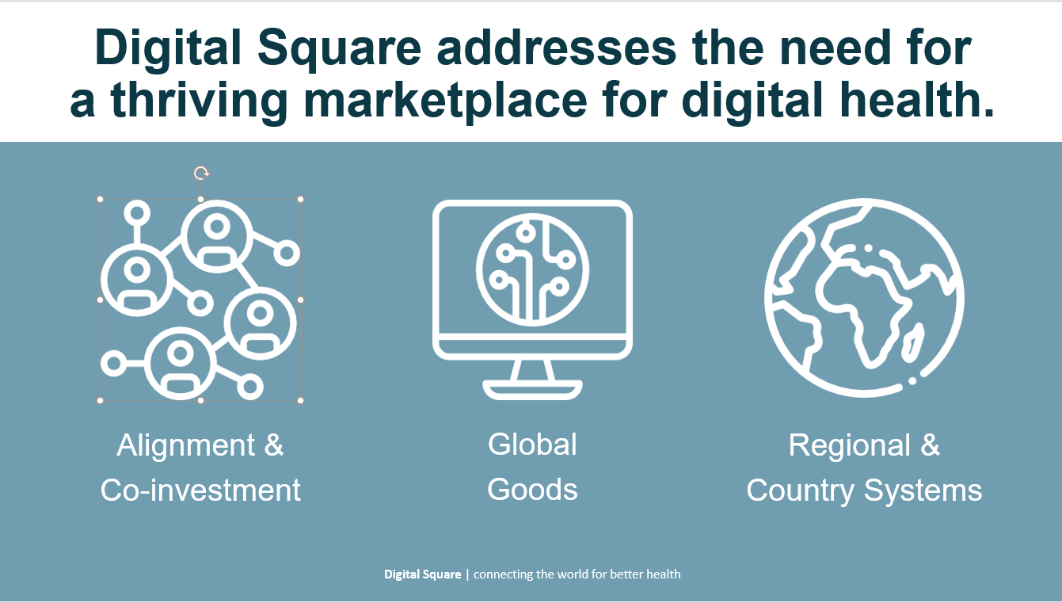
Overview of Digital Square
Digital Square is a digital health marketplace—or ‘square’—where supply and demand come together to accelerate health equity through the development, adoption, scale, and delivery of digital health innovations in low- and middle-income countries. We help funders, country leaders, implementers, and global policy makers learn about high-quality, trustworthy digital health software that is appropriate for low-resource settings.
Notes:
Digital Square is a multi-donor initiative that brings together partners across the digital health ecosystem to work together to drive the development, adoption, scale, and delivery of digital health innovations in low resource settings. We convene and help investors, country leaders, implementers, governments and global policy makers move the needle toward digital transformation, specifically with a focus on quality, trustworthy digital tools appropriate for low resource settings.

Slide 38
Annex

Slide 39
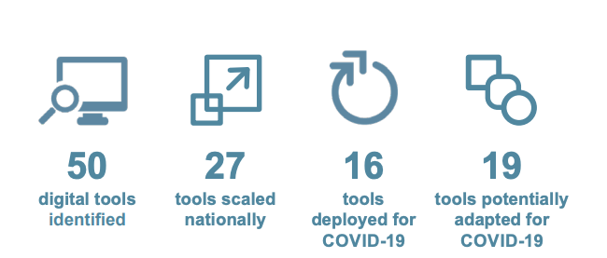
Country Briefs (II): Overview of existing tools
Country briefs provide a quick snapshot of how many digital health tools and the use cases addressed by the tools. This allows a quick assessment of which use cases have many existing tools and where additional tools may be needed.
Notes:
Through this project, Digital Square developed a highly visual brief for each country, identifying which tools are currently in use in the country, which tools have already been used in the country’s COVID-19 response, and where there are opportunities for quick adaptation of existing tools across COVID-19 response use cases. Digital Square prioritized dissemination of the country briefs and supplemental resources with national governments, investors, and other stakeholders.
How to use country briefs:
Identify what information exists about current tools used in countries and how those tools are currently being used in the pandemic response.
Identify opportunities to adapt and scale current tools for expanded use cases.
Identify gaps - i.e. where some countries may not be using any tools for things like laboratory information systems for the pandemic.
Use this information in conversations with Ministries of Health about where and how they want to use digital health technologies in the pandemic response.
For countries with limited digital tools already in use, recommend using the information to adapt and scale what tools they have AND looking at tools available that map to use case gaps.
For countries already using many tools, the information in the briefs offer opportunities to address any current gaps. It is also an opportunity to look at how tools are being used in the response and support the government to enable interoperability of tools as well as explore advanced analytics to inform decision making.

Slide 40
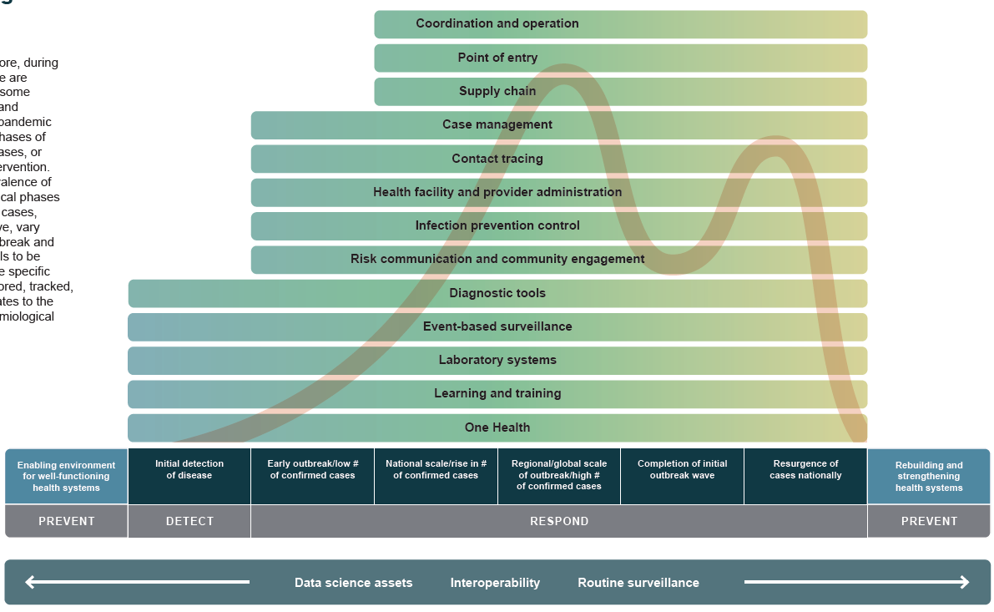
DATEC purposes
Visualize when and how digital applications and tools can be strategically used during phases of an outbreak
Identify tools and applications that should be in place before an outbreak and recommend strategies for improving digital tools after an outbreak
Demonstrate the role data science, system interoperability, and routine surveillance play before and during an outbreak
Show how digitals applications and tools support the utilization of outbreak control techniques (e.g., diagnostics, therapeutics, vaccines)
Offer examples of how digital tools can mitigate stressors on health workers, facilities, and systems during an outbreak
Provide information on which investors fund specific use cases to facilitate coordination and smart investments
Notes:
The Digital Applications and Tools Across an Epidemiological Curve (DATEC) is a strategic framework for governments, investors, implementing organizations, and the digital health community at-large to better understand how existing digital tools can be adapted and used during different phases of an outbreak. This framework is meant to highlight how digital technologies, which should already be present in a country, can most strategically be leveraged to augment response during an epidemic and/or pandemic. This V1 framework is not specific to COVID-19 but uses the COVID pandemic as a reference to illustrate use of digital tools, such as contact tracing, laboratory information systems etc.
DATEC is a part of the Map and Match package of resources that will be disseminated with each country brief. The framework is housed on the Digital Square website as a resource for other programs.
https://digitalsquare.org/resourcesrepository/datec

Slide 41
Identifying Scaled Systems
Map and Match focused on identifying scaled systems by collecting information on, where available:
Number of end users: determining who is using a tool and where. Information can be evaluated using the number of health workers, number of clients, or number of facilities using a tool.
Breadth of tool use: understanding the number ways in which a tools is used, such as use cross health focus areas or digital health intervention areas.
Institutionalization: delves into how well the tool is integrated into the country’s priorities by understanding if the tools has dedicated resources, and/or is included as a tool that is necessary for health workers to use in formal job descriptions.
Our scale document can be found here.

Slide 42
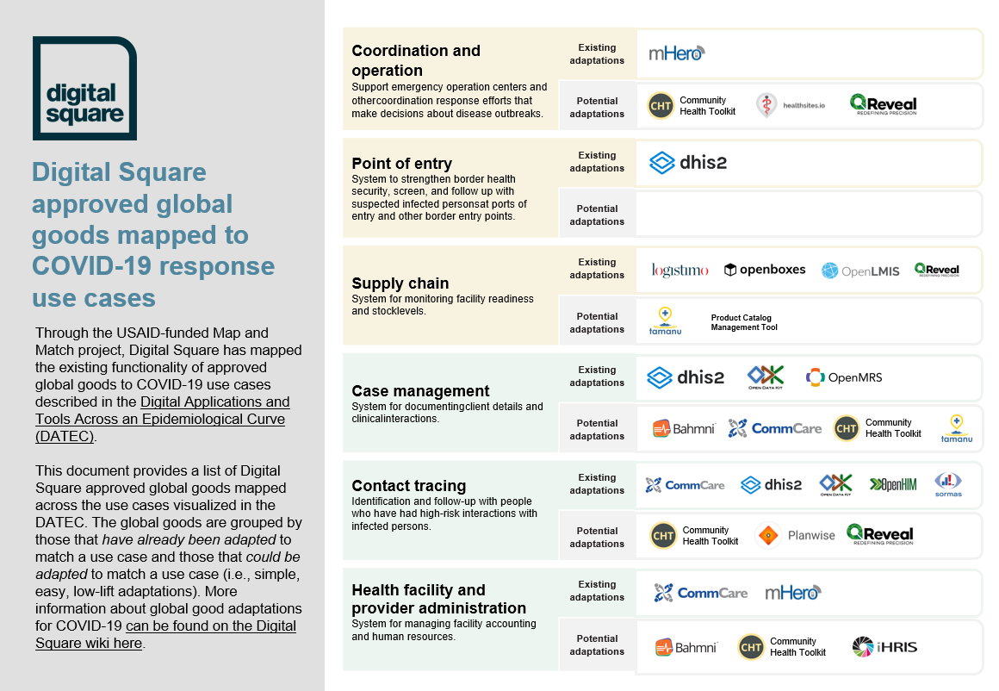
Global Goods Pandemic Uses
Map and Match also mapped Digital Square approved Global Goods to provide a more comprehensive view into how these open-source tools can be used to address pandemic use cases.
The Digital Square wiki also provides more in-depth information about these tools.

