Slide 1
Republic of Malawi
Status of Digital Health Strategy in Malawi
Ministry of Health

Slide 2
Development of eHealth Strategy was completed in Dec. 2014
Followed WHO/ITU eHealth Strategy Development Toolkit
Approval was in December, 2015.
Had only two years of implementation with expiry in 2016

Slide 3
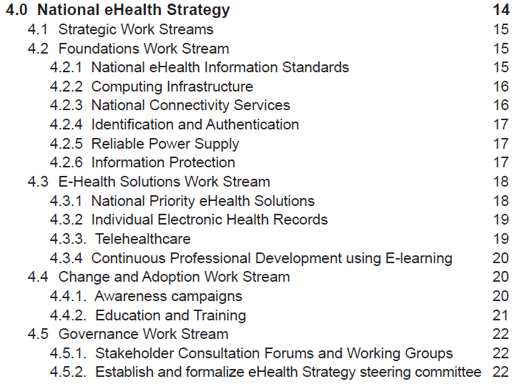

Slide 6
Health Sector Strategic Plan
HIS Strategy
eHealth Strategy
Step 1
Step 2
Step 3

Slide 7
Strategy Progress
HSSP II already in final stages
M&E Framework for HSSP II at advanced stage:
Indicator definition
Key objectives
Key priority activities HIS Strategy
Results matrix
Stakeholder Mapping
Notes:
Building from 2003 Indicator Handbook for Measuring Health System Performance (110 indicators), and the 2011-2016 Health Sector Strategic Plan (38 indicators)
MOH Departments consulted, indicators divided into two groups:
National Health Indicators
Program-level Indicators
Effort to align indicators with comparable Global Indicators (e.g. Global Reference List of 100 Core Health Indicators)
Well-defined numerators, denominators, sources, references, definitions, and importance
Many updates require revision of HMIS data collection forms, retraining, etc.

Slide 8
Priority Areas for Implementation
Notes:
Building from 2003 Indicator Handbook for Measuring Health System Performance (110 indicators), and the 2011-2016 Health Sector Strategic Plan (38 indicators)
MOH Departments consulted, indicators divided into two groups:
National Health Indicators
Program-level Indicators
Effort to align indicators with comparable Global Indicators (e.g. Global Reference List of 100 Core Health Indicators)
Well-defined numerators, denominators, sources, references, definitions, and importance
Many updates require revision of HMIS data collection forms, retraining, etc.

Slide 9
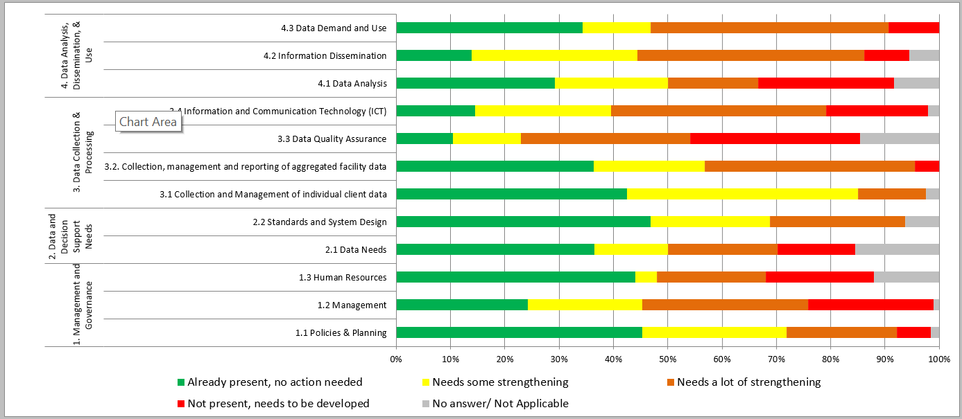
Notes:
Building from 2003 Indicator Handbook for Measuring Health System Performance (110 indicators), and the 2011-2016 Health Sector Strategic Plan (38 indicators)
MOH Departments consulted, indicators divided into two groups:
National Health Indicators
Program-level Indicators
Effort to align indicators with comparable Global Indicators (e.g. Global Reference List of 100 Core Health Indicators)
Well-defined numerators, denominators, sources, references, definitions, and importance
Many updates require revision of HMIS data collection forms, retraining, etc.

Slide 10
Priority Areas for Implementation
Notes:
Building from 2003 Indicator Handbook for Measuring Health System Performance (110 indicators), and the 2011-2016 Health Sector Strategic Plan (38 indicators)
MOH Departments consulted, indicators divided into two groups:
National Health Indicators
Program-level Indicators
Effort to align indicators with comparable Global Indicators (e.g. Global Reference List of 100 Core Health Indicators)
Well-defined numerators, denominators, sources, references, definitions, and importance
Many updates require revision of HMIS data collection forms, retraining, etc.

Slide 11
Summary from M&E Key Priority Actions:
Strengthen the interoperability of HIS systems
Strengthen ICT human resources capacity
Expand implementation of patient level electronic systems
Strengthen ICT infrastructure (connectivity, power, devices etc)
Computerize HIS subsystems eg LMIS, LIMS, etc
Strengthen community level systems and link with facility level systems

Slide 12
DH&I collaboration and participation:
Financial resource mobilization
Technical assistance to support local team on updating of HIS Strategy, eHealth Strategy
Multi-sectoral Promotion of ICT as a key component of measurement and accountability to achieve the SDGs
Development of standards and methodologies and supporting adoption and diffusion eg Interoperability standards

Slide 13
Thank You

