Slide 1


Launched March 9 2016 at UN Statistical
Commission in side event
www.healthdatacollaborative.org

Slide 2

WHAT IS THE HEALTH DATA COLLABORATIVE?

Slide 3

A JOINT EFFORT BY COUNTRIES, DEVELOPMENT PARTNERS, CIVIL SOCIETY AND ACADEMIA TO:
STRENGTHEN NATIONAL HEALTH INFORMATION SYSTEMS
IMPROVE THE QUALITY OF HEALTH DATA
TRACK PROGRESS TOWARDS SUSTAINABLE DEVELOPMENT GOALS

Slide 4

WHY DO WE NEED
THE HEALTH DATA
COLLABORATIVE APPROACH?

Slide 5
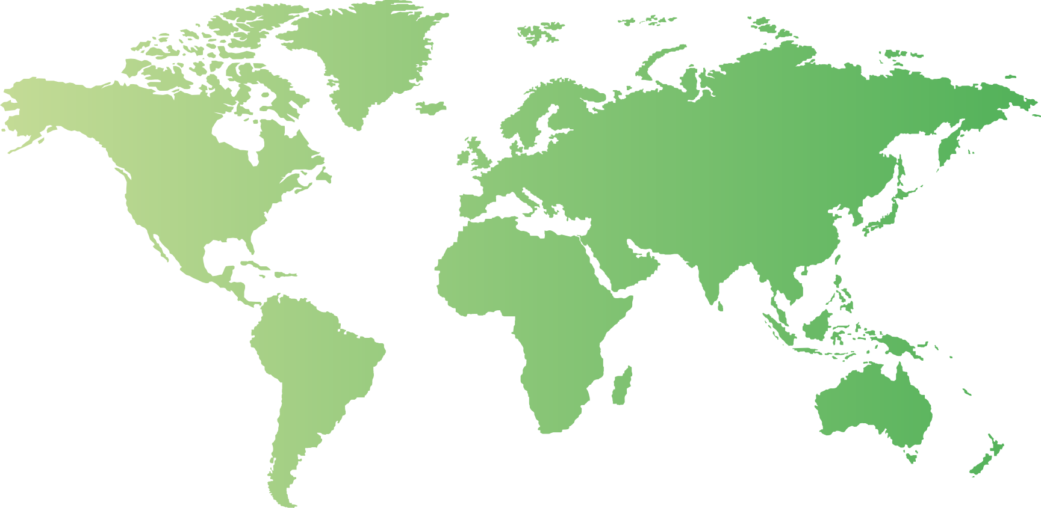


KENYA
PARTNER INVESTMENTS IN DIGITAL HEALTH DATA SYSTEMS THAT ARE INCOMPATIBLE
WITH DHIS 2 SOFTWARE USED BY HEALTH MINISTRY
ZIMBABWE
PARTNERS REQUESTING REPORTING ON 230 INDICATORS THAT FALL OUTSIDE OF NATIONAL HEALTH PLAN

Slide 6


CAMBODIA
DONORS AND HEALTH MINISTRY REQUIRING
19 MONTHLY REPORTING FORMS, OVERWHELMING HEALTH WORKS
EBOLA-AFFECTED COUNTRIES
DONOR-DRIVEN, FRAGMENTED DATA SYSTEMS HAMPERED EFFECTIVE USE OF DATA DURING OUTBREAK
HEALTH FACILITY SURVEYS
PARTNERS HAVE DEVELOPED AT LEAST
8 TOOLS COLLECTING OVERLAPPING INFORMATION
6

Slide 7

THIS RESULTS IN
FRAGMENTED, UNCOORDINATED DATA SYSTEMS
DUPLICATED INVESTMENTS
TAKING HEALTH WORKERS’ TIME AWAY FROM PATIENT CARE

Slide 8

WHAT ARE WE
DOING ABOUT THIS?

Slide 9
CHANGING THE WAY WE WORK TOGETHER
PRIMARY STRATEGIES
OUTPUT
RESULTS
Alignment of funding and technical support for a single strong country health information system
Strengthened country systems for monitoring programmes and accountability
Increased efficiency of domestic and external investments in comparable, timely and accurate health
Package of standards, tools and repository of information available to all countries
Better reporting of national and global progress on SDGs

Slide 10

WHY NOW?

Slide 11


COUNTRIES NEED GOOD QUALITY DATA TO TRACK PROGRESS TOWARD THE HEALTH-RELATED SUSTAINABLE DEVELOPMENT GOALS, INCLUDING UNIVERSAL HEALTH COVERAGE

Slide 12

WHAT WILL WE DELIVER?

Slide 13





Technical package of tools and standards to strengthen country data systems
Improve birth and death registrations
Improve facility and community data, including disease surveillance
Improve collection of health workforce data
Improve tracking of health spending
Improve capacity for data analytics and use

Slide 14
Kenya
Country action
& regional collaboration
Digital health
systems and interoperability
Health workforce
Malawi
Health
systems
monitoring
Health financing
Civil society
(CHESTRAD, AEHIN)
Global
Public Goods (harmonized data tools and standards)
Quality
of care / PHCPI
Logistics Management Information Systems
Facility and
community
data
RHIS/
disease surveillance
Household
Survey Network
DHS-MICS-LSMS
Facility
surveys
CRVS coordination mechanisms (IAWG, + regional bodies)
Data analytics
and use
Community
data
Country & regional platforms
Global / country
data and
statistics
Existing collaborative platforms
HDC Working Groups
14

Slide 15
DELIVERABLES BY WORKING GROUP
Digital health & interoperability
Country and regional engagement
M&E assessment, planning & costing tool
Engagement with 4-5 pathfinder countries + 4 specific needs
Collective technical action to support country M&E /HIS priorities
Facility and community data
Package of data standards (RHIS curriculum, indicators, data quality, analyses, use)
Joint investment plan for DHIS
Quality of care metrics and methodologies
Harmonized facility survey indicators, modules
Package of data standards (RHIS curriculum, rapid assessment tools, core indicators, data quality metrics, analyses, dashboards, master facility list, unique IDs ++ )
Joint investment plan for DHIS 2 development, implementation, maintenance
Standard set of facility survey questions and modules
Quality of care metrics & methodology (including implementation research)
DELIVERABLES BY WORKING GROUP
Global public gods for HIS
Civil Registration and Vital Statistics (CRVS)
E-learning course on CRVS
Aligned country support and best practices
Global & country data & statistics
Health systems monitoring
Handbook on national health workforce accounts
Package of guidelines and tools for unified resource tracking
Digital health systems and interoperability
Guidelines & standards for national digital health architectures
Country strategic digital health investment plans /interoperability lab
Functioning use cases ( eg. IDSR integrated into HMIS, open health facility registry)
Global & country data & statistics
Analysis & use
Country assessments on barriers to data use & best practices
Guidance and suite of electronic tools to strengthen institutional capacity
Country & global data & statistics
Global Health Observatory revamped for SDG health monitoring
State of the art analytical & visualization tools
Open data policies & national health observatories
Global health observatory revamped for health SDG monitoring
Open data policy guidance & national health observatories
15

Slide 16

HOW DO WE ENGAGE
WITH COUNTRIES?

Slide 17
GETTING BEHIND COUNTRY PRIORITIES
TB
cMYP (immunization)
GLOBAL STRATEGY
HIV/AIDS
National Health Sector Strategic Plan
NCDs
MALARIA
OTHER HEALTH PROGR.
Comprehensive National M&E Plan
Common investment framework for M&E
FOUNDATIONS
GLOBAL FUND
BILATERAL/
MULTILATERAL
FUNDING
DOMESTIC
FUNDING
GAVI
GFF
Coordinated technical support and implementation

Slide 18
COUNTRY ENGAGEMENT APPROACH
Country-led with strong country stewardship
Opportunities for collective action & joint investment
Broad stakeholder participation
Principles of engagement
Strategic request for collective action linked to M&E /HIS plans
Focused request for collective action (i.e. HMIS)
Joint learning & documenting best practice
Type of engagement
In 2016-17, at least 5 countries (starting with Kenya and Malawi)
Approach will be scaled up in more countries over subsequent years
Where
we engage

Slide 19
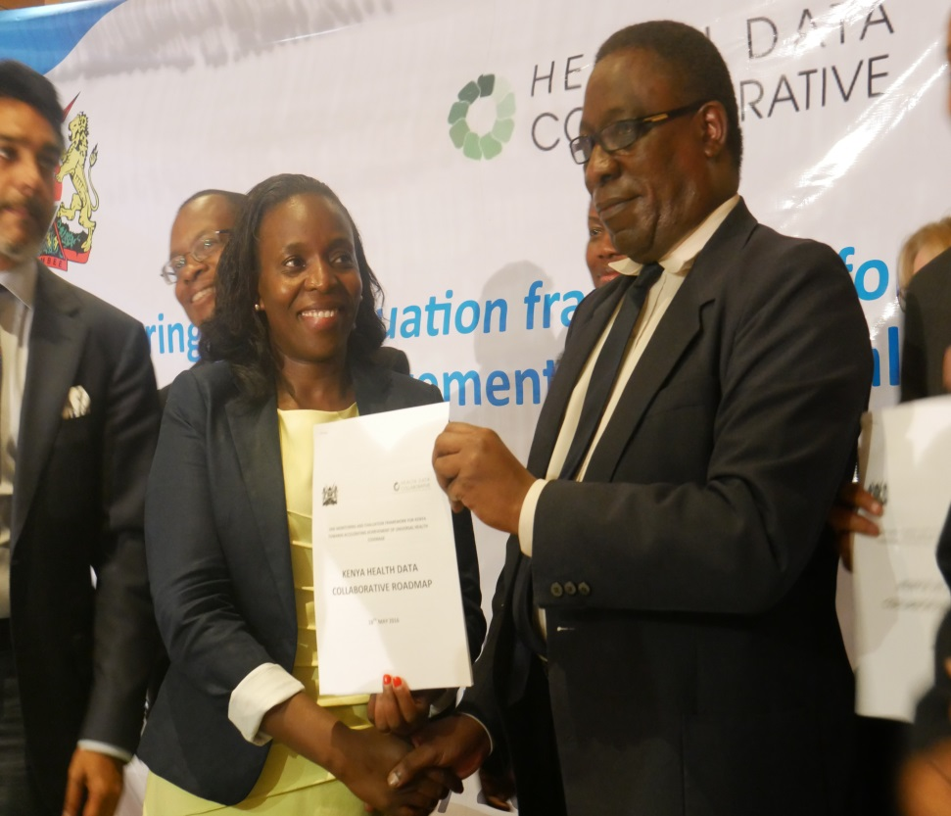

KENYA HEALTH DATA COLLABORATIVE
(Launched May 18, 2016)
ALL STAKEHOLDERS SUPPORTING KENYA’S M&E PRIORITIES
DATA ANALYTICS CAPACITY
QUALITY OF CARE
KENYA HEALTH DATA OBSERVATORY
CRVS
MID-TERM REVIEW

Slide 20
“WE NOW EXPECT ALL HEALTH DATA COLLABORATIVE PARTNERS TO PULL IN THE SAME DIRECTION AND IN LINE WITH OUR OWN VISION AND GOALS.”
DR NICHOLAS MURAGURI,
PRINCIPAL SECRETARY,
KENYA MINISTRY OF HEALTH

Slide 21

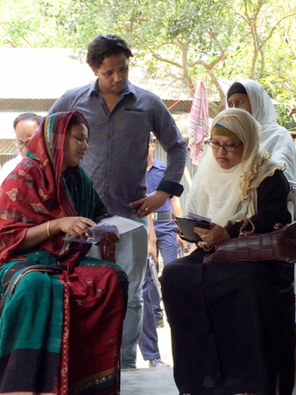
REGIONAL ENGAGEMENT IN ASIA
Peer learning and review
Bangladesh
Nepal, Philippines, Cambodia, Bhutan, Indonesia, Myanmar and South Africa

Slide 22
HOW WILL WE MEASURE SUCCESS?

Slide 23
MONITOR PERFORMANCE OF PROGRESS AGAINST
LOGFRAME METRICS
GLOBAL REPORT ON STATE OF COUNTRY HIS
(2017)

Slide 24
HOW DO WE INTERACT WITH OTHER PARTNERSHIPS?

Slide 25
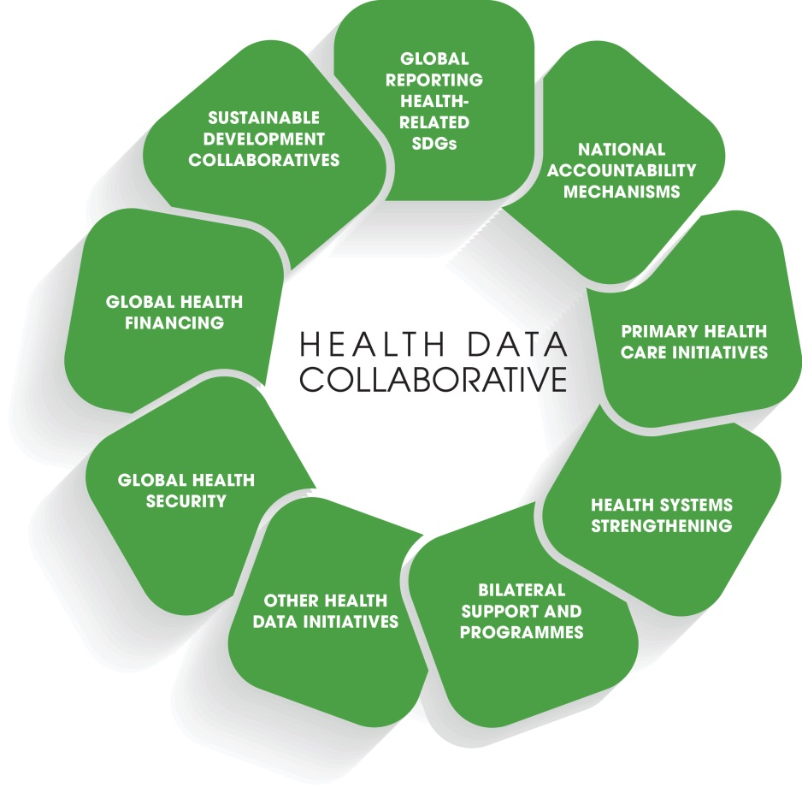
HDC WORK WILL ENGAGE & LEVERAGE DATA EFFORTS OF
GLOBAL HEALTH INITIATIVES & NETWORKS

Slide 26
WHO ARE THE PARTNERS?

Slide 27


































TO-DATE: 32 PARTNER COMMITMENTS

